Slide 1
ỦY BAN NHÂN DÂN QUẬN 3 PHÒNG GIÁO DỤC VÀ ĐÀO TẠO

Slide 2
ỦY BAN NHÂN DÂN QUẬN 3 TRƯỜNG TIỂU HỌC NGUYỄN THI
MÔN TIẾNG ANH LỚP 4
Giáo viên thực hiện: Lê Toàn Thắng
Năm học: 2021 - 2022

Slide 3
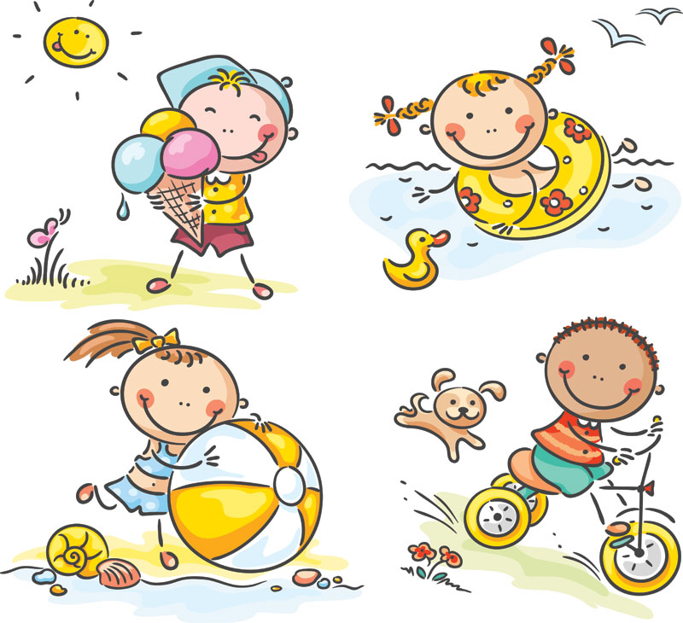
GRADE 4
UNIT TWO
My weekend
Lesson 3

Slide 7
Let’s play a game.

Slide 8
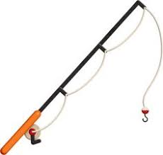
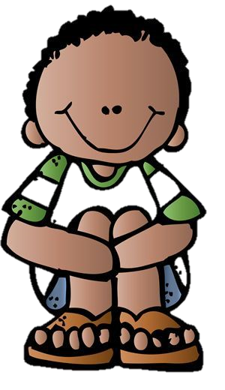
Great
Does he like fishing?
Yes, he does.
No, he doesn’t.

Slide 9
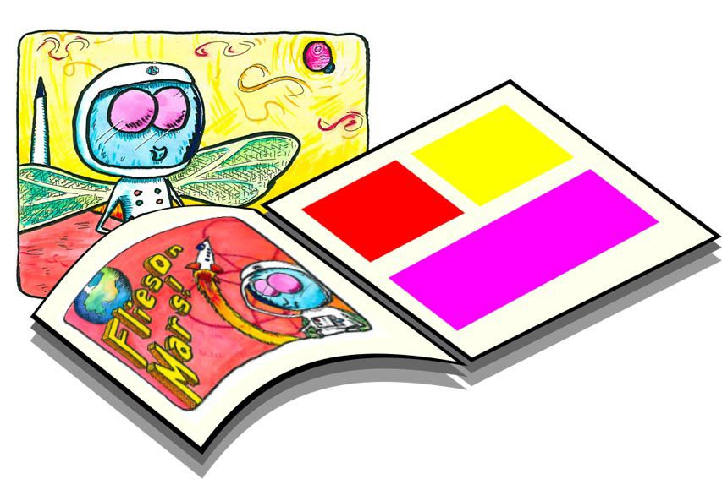
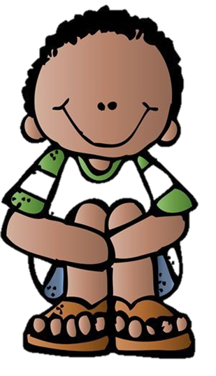
Great
Does he like reading comics ?
Yes, he does.
No, he doesn’t.

Slide 10
Great
Does he like playing basketball?
Yes, he does.
No, he doesn’t.

Slide 11
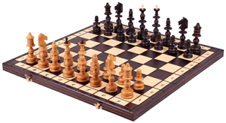
Great
Does he like playing chess?
Yes, he does.
No, he doesn’t.

Slide 12
Great
Does he like taking photos?
Yes, he does.
No, he doesn’t.

Slide 13
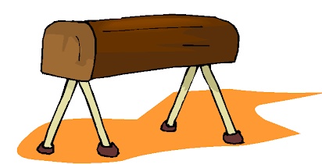
End
Does he like doing gymnastics?
Yes, he does.
No, he doesn’t.

Slide 14
Pair work: Choose a boy. Ask and answer.

Slide 15
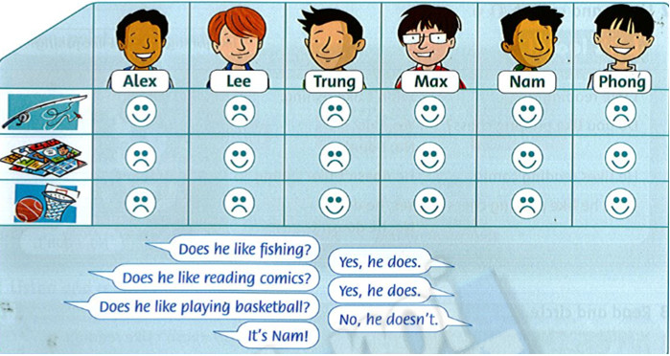

Slide 16
Task: write
Phong doesn't like fishing. He likes reading comics.
He …

Slide 17
Work in pairs
Talk about your writing

Slide 18
Listen and point

Slide 20
LISTEN and SING

Slide 22
GROUPWORK: Sing and do

Slide 23
PERFORMANCE TIME!!!!

Slide 24
Workbook time!!!

Slide 27
ỦY BAN NHÂN DÂN QUẬN 3 TRƯỜNG TIỂU HỌC NGUYỄN THI
XIN CHÂN THÀNH CÁM ƠN
Giáo viên thực hiện: Lê Toàn Thắng
Trang website của trường Nguyễn Thi https://thnguyenthiq3.hcm.edu.vn

